Slide 1

TSF3313 FILE SYSTEM FORENSICS
Chapter 2
Computer Foundations

Slide 2
Data Organization
The purpose of device investigation is to process digital data, so that we need to understand some of the basics of data.
We will look at binary and hexadecimal numbers, data sizes, endian ordering, and data structures.
These concepts are essential to know how data are stored.

Slide 3
Data Organization
Computers use binary, which means that there are only 0s and 1s.
Each 0 or 1 is called a bit, and bits are organized into groups of 8 called bytes.
Binary numbers are similar to decimal numbers except that decimal numbers have 10 different symbols (0 to 9) instead of only 2.
Binary, Decimal and Hexadecimal

Slide 4
Data Organization
A decimal number is a series of symbols, and each symbol has a value.
The symbol in the right-most column has a value of 1, and the next column to the left has a value of 10.
Each column has a value that is 10 times as much as the previous column.
For example, the second column from the right has a value of 10, the third has 100, the fourth has 1,000, and so on.
Binary, Decimal and Hexadecimal (cont.)

Slide 5
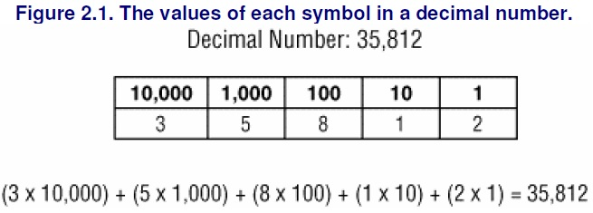
Data Organization
Binary, Decimal and Hexadecimal (cont.)

Slide 6
Data Organization
The right-most column is called the least significant symbol, and the left-most column is called the most significant symbol.
With the number 35,812, the 3 is the most significant symbol, and the 2 is the least significant symbol.
Binary, Decimal and Hexadecimal (cont.)

Slide 7
Data Organization
A binary number has only two symbols (0 and 1), and each column has a decimal value that is two times as much as the previous column.
Therefore, the right-most column has a decimal value of 1, the second column from the right has a decimal value of 2, the third column's decimal value is 4, the fourth column's decimal value is 8, and so on.
To calculate the decimal value of a binary number, we simply add the value of each column multiplied by the value in it.
Binary, Decimal and Hexadecimal (cont.)

Slide 8
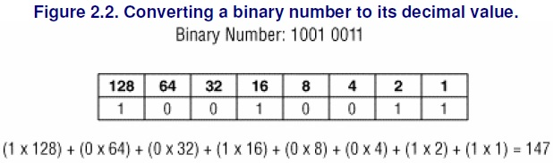
Data Organization
Binary, Decimal and Hexadecimal (cont.)

Slide 9
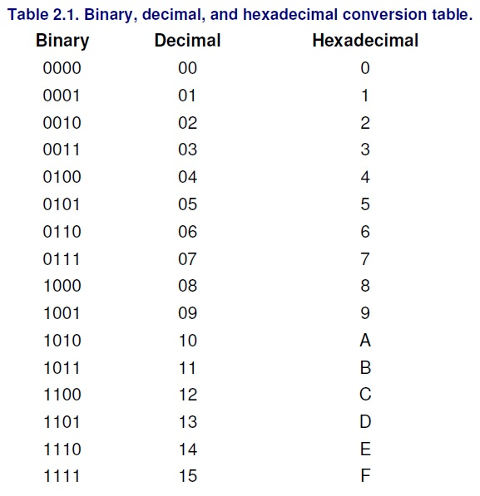
Data Organization
Binary, Decimal and Hexadecimal (cont.)

Slide 10
Data Organization
Binary and hexadecimal are frequently used when looking at raw data.
Hexadecimal is preceded by '0x' to differentiate it from a decimal number.
The decimal value of each column in a hexadecimal number increases by a factor of 16.
Therefore, the decimal value of the first column is 1, the second column has a decimal value of 16, and the third column has a decimal value of 256.
Binary, Decimal and Hexadecimal (cont.)

Slide 11
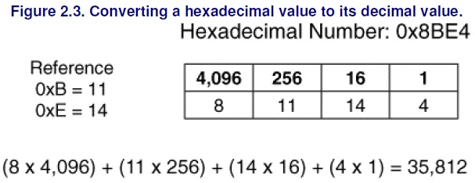
Data Organization
Binary, Decimal and Hexadecimal (cont.)

Slide 12
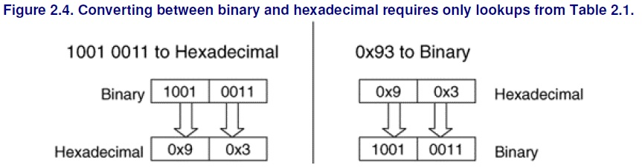
Data Organization
Binary, Decimal and Hexadecimal (cont.)

Slide 13
Data Organization
Sometimes, we want to know the maximum value that can be represented with a certain number of columns.
This can be done by raising the number of symbols in each column by the number of columns and subtract 1.
Subtract 1 because we need to take the 0 value into account.
For example, with a binary number we raise 2 to the number of bits in the value and subtract 1.
Therefore, a 32-bit value has a maximum decimal value of
2³² - 1 = 4,294,967,295
Binary, Decimal and Hexadecimal (cont.)

Slide 14
Data Organization
To store digital data, we need to allocate a location on a storage device.
You can think of this like the paper forms where you need to enter each character in your name and address in little boxes.
The name and address fields have allocated space on the page for the characters in your name.
With digital data, bytes on a disk or in memory are allocated for the bytes in a specific value
Data Sizes

Slide 15
Data Organization
A byte is the smallest amount of space that is typically allocated to data.
A byte can hold only 256 values, so bytes are grouped together to store larger numbers.
Typical sizes include 2, 4, or 8 bytes
Computers differ in how they organize multiple-byte values. Some of them use big-endian ordering and put the most significant byte of the number in the first storage byte, and others use little-endian ordering and put the least significant byte of the number in the first storage byte.
Data Sizes (cont.)

Slide 16
Data Organization
Recall that the most significant byte is the byte with the most value (the left-most byte), and the least significant byte is the byte with the least value (the right-most byte).
Data Sizes (cont.)

Slide 17
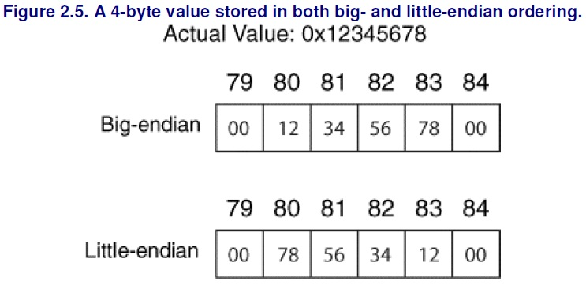
Data Organization
Data Sizes (cont.)

Slide 18
Data Organization
IA32-based systems (i.e., Intel Pentium) and their 64-bit counterparts use the little-endian ordering, so we need to "rearrange" the bytes if we want the most significant byte to be the left-most number.
Sun SPARC and Motorola PowerPC (i.e., Apple computers) systems use big-endian ordering.
Data Sizes (cont.)

Slide 19
Data Organization
We must now consider how it stores letters and sentences.
The most common technique is to encode the characters using ASCII or Unicode.
ASCII assigns a numerical value to the characters in American English.
For example, the letter 'A' is equal to 0x41, and '&' is equal to 0x26.
The largest defined value is 0x7E, which means that 1 byte can be used to store each character.
There are many values that are defined as control characters and are not printable, such the 0x07 bell sound.
A more detailed ASCII table can be found at http://www.asciitable.com/.
Strings and Character Encoding

Slide 20
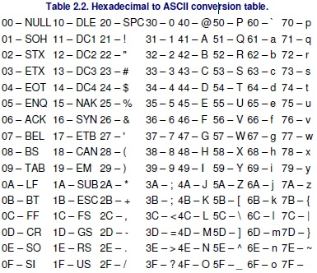
Data Organization
Strings and Character Encoding (cont.)

Slide 21
Data Organization
To store a sentence or a word using ASCII, we need to allocate as many bytes as there are characters in the sentence or word.
Each byte stores the value of a character.
The endian ordering of a system does not play a role in how the characters are stored because these are separate 1-byte values.
Therefore, the first character in the word or sentence is always in the first allocated byte.
The series of bytes in a word or sentence is called a string.
Many times, the string ends with the NULL symbol, which is 0x00.
Strings and Character Encoding (cont.)

Slide 22
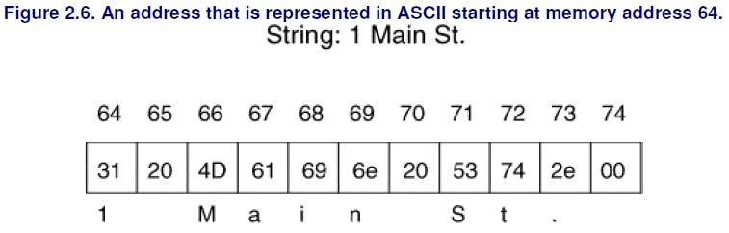
Data Organization
Strings and Character Encoding (cont.)

Slide 23
Data Organization
There are three ways of storing a Unicode character.
The first method, UTF-32, uses a 4-byte value for each character, which might waste a lot of space.
The second method, UTF-16, stores the most heavily used characters in a 2-byte value and the lesser-used characters in a 4- byte value.
Therefore, on average this uses less space than UTF-32. The third method is called UTF-8, and it uses 1, 2, or 4 bytes to store a character.
Each character requires a different number of bytes, and the most frequently used bytes use only 1 byte.
UTF-8 and UTF-16 use a variable number of bytes to store each character and, therefore, make processing the data more difficult.
UTF-8 is frequently used because it has the least amount of wasted space and because ASCII is a subset of it.
A UTF-8 string that has only the characters in ASCII uses only 1 byte per character and has the same values as the equivalent ASCII string.
Strings and Character Encoding (cont.)

Slide 24
Data Organization
How are data stored in specific file systems?
With a paper form, a label precedes the boxes and tells you that the boxes are for the name or address.
Computers do not, generally, precede file system data with a label.
Instead, they simply know that the first 32 bytes are for a person's name and the next 32 bytes are for the street name.
Data Structures

Slide 25
Data Organization
Computers know the layout of the data because of data structures.
A data structure describes how data are laid out.
It works like a template or map.
The data structure is broken up into fields, and each field has a size.
Data Structures (cont.)

Slide 26
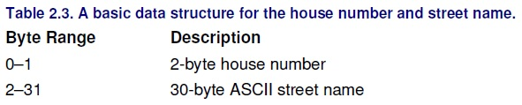
Data Organization
Data Structures (cont.)

Slide 27

Data Organization
Data Structures (cont.)
Output from the xxd Unix tool.
The left column is the byte offset of the row in decimal, the 8 middle columns are 16 bytes of the data in hexadecimal, and the last column is the ASCII equivalent of the data.
A '.' exists where there is no printable ASCII character for the value.
Each hexadecimal symbol represents 4 bits, so a byte needs 2 hexadecimal symbols.

Slide 28
Data Organization
Data Structures (cont.)
Each address is 32 bytes, so the first address is in bytes 0 to 31. Bytes 0 to 1 should be the 2 byte number field, and bytes 2 to 31 should be the street name.
Bytes 0 to 1 show us the value 0x0100. The data are from an Intel system, which is little-endian, and we will therefore have to switch the order of the 0x01 and the 0x00 to produce 0x0001.
When we convert this to decimal we get the number 1.

Slide 29
Data Organization
Data Structures (cont.)
The second field in the data structure is in bytes 2 to 31 and is an ASCII string, which is not effected by the endian ordering of the system, so we do not have to reorder the bytes.
We can either convert each byte to its ASCII equivalent or, in this case, cheat and look on the right column to see "Main St.."
This is the value we previously wrote.
We see that another address data structure starts in byte 32 and extends until byte 63. You can process it as an exercise (it is for 25 South St).

Slide 30
Notable GitHub / Open Source File Carving Tools
Repository | Description | Strengths / Use in Teaching | Limitations
wahlflo/pyFileCarving | A Python CLI script for file carving (PE, PDF, pictures) (GitHub) | Very simple, easy to read and modify in class. Great demo material. | Not optimized for performance or fragmented files.
sleuthkit / scalpel | Scalpel is a well-known file carving tool (part of the Sleuth Kit project) (GitHub) | Robust, tested, supports multiple file types. Good for practical labs. | More complex to build; configuration (scalpel.conf) must be tuned.
libyal / reviveit | Proof-of-concept recovery / carving tool using “Smart Carving” techniques (GitHub) | More advanced, shows research ideas. Good for advanced students. | Less polished, possibly incomplete support for many file types.
Lakshmipathi / extcarve | Semantic file carving tool with support for Ext2/Ext3/Ext4 and file types like jpg, pdf, etc. (GitHub) | Useful for teaching Linux file system carving. | May not handle fragmentation fully; code base is older.
bluebears-dev / carve | A “naive magic number based” file carver (simple) (GitHub) | Very simple — good starting point to show how magic number carving works. | Minimal features; may fail on complex or fragmented files.
sondosaabed / File-Carving-Tool | Java tool for signature-based carving, fragmentation handling, hashing, etc. (GitHub) | Good GUI or teaching demo for students who prefer Java. | Probably not as effective for performance or large datasets.
Will-Banksy / searchlight | A newer, GPU-accelerated / validation-aware carving tool (PNG, JPEG, ZIP) (GitHub) | Shows more modern techniques (validation, fragmented reconstruction). Great for research topics. | Still “work in progress,” might not be as stable as production tools.

Slide 31

Thank you
تريما کاسيه
شكرا
谢谢
நன்றி

